Slide 1


Ultrasonic sensors
STEM
Notes:
Today we will be completing the BRONZE crest award

Slide 2
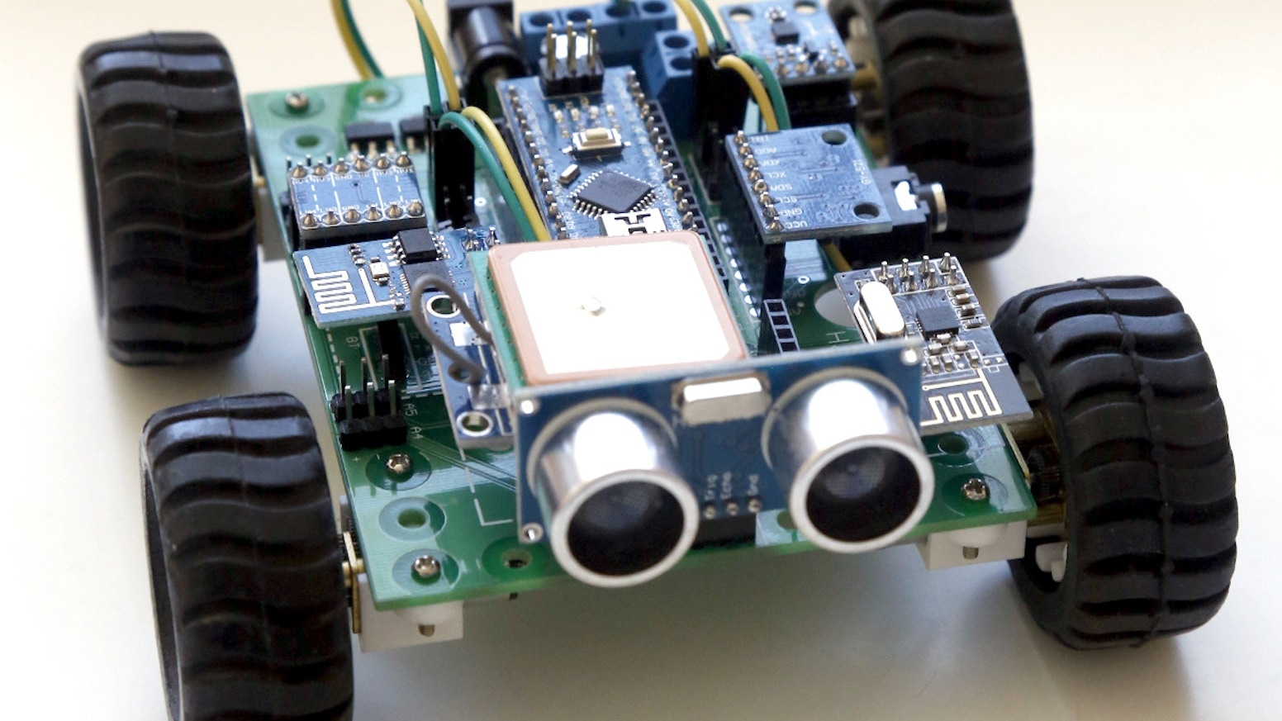
CREST AWARDS
What will we cover?
What will you learn now?
What is an ultrasonic sensor. How to deal with unknown environments. Thinking like an engineer

Slide 3
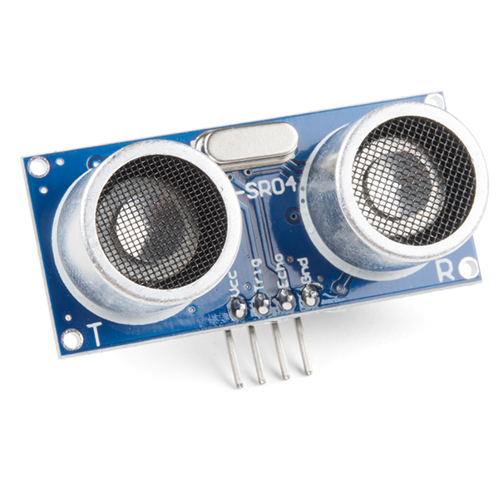
CREST AWARDS
Ultrasonic Sensors
Ultrasonic sensors are used to measure distance.
Based on this image, how do you think they do this?

Slide 4
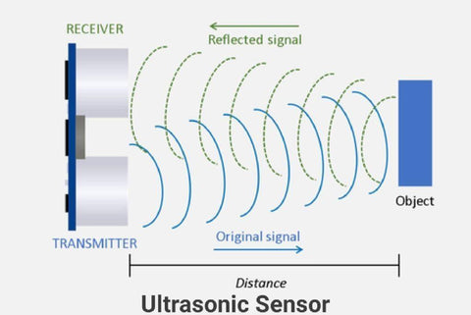
CREST AWARDS
Sound waves

Slide 5
CREST AWARDS
Ultrasonic Sensors
Now we understand how this device works, how to we implement this into our robot?
Thats for you as engineers to find out. Use "How to Mechatronics – Ultrasonic sensor" as a starting point.
Think about in what situations we want to know distance, and why we might use them

Slide 6
CREST AWARDS
Going forward
You should now know:
What an ultrasonic sensor is, and have some use for it in your machines.

